Slide 1

Phishing Awareness Training
How to Recognize, Avoid, and Report Phishing Attacks

Slide 2

INTRODUCTION
What is Phishing?
Phishing is a type of cyberattack where attackers trick individuals into revealing sensitive information such as passwords or credit card details.

Slide 3
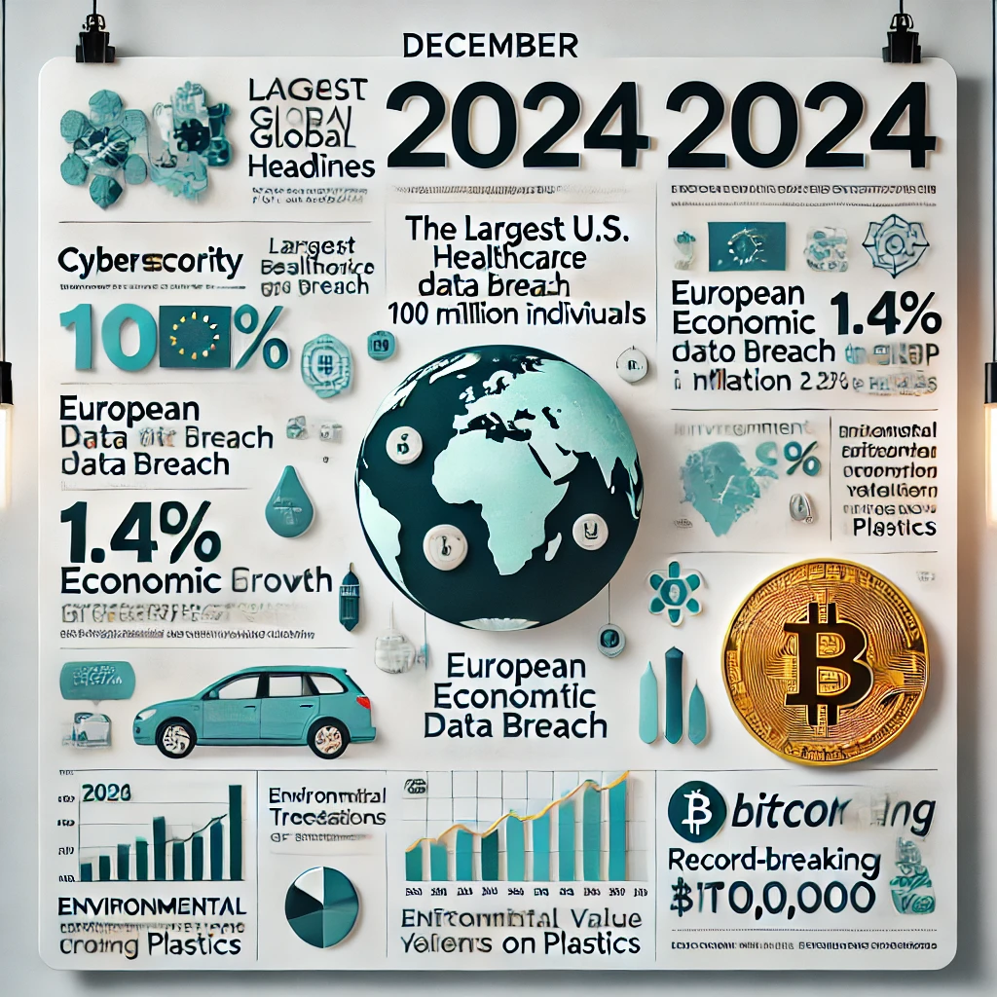
WHY IS PHISHING A THREAT?
Widespread Impact on Organizations
Phishing is responsible for over 90% of cyberattacks worldwide.
Example: In 2024, a global tech company lost sensitive data after employees clicked on a phishing link, exposing thousands of user accounts.

Slide 4
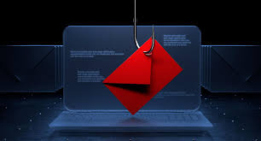
TYPES OF PHISHING ATTACKS
Email Phishing
Fake Emails Pretending to Be Legitimate
Cybercriminals send emails that appear to be from trusted organizations (e.g., banks, delivery services).
They often request sensitive information like passwords, credit card numbers, or personal data.
Tactics Used in Email Phishing
Use of urgent language: “Your account will be suspended, click here to verify.”
Contain malicious links or attachments designed to steal data or install malware.

Slide 5
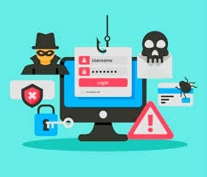
Spear Phishing
Highly Targeted Attacks
Unlike regular phishing, spear phishing targets specific individuals or organizations using personalized information (e.g., name, job title).
Attackers often research their victims via social media or public records to make the email appear authentic.
Appears to Come from a Trusted Source
Emails often look like they are from a colleague, boss, or trusted partner.
Example: “Hi [Your Name], please review this urgent document” with a malicious attachment or link.

Slide 6
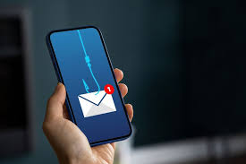
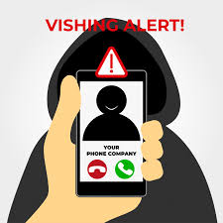
Smishing & Vishing
Smishing - Phishing via SMS
Smishing involves sending fake text messages (SMS) to trick victims into sharing personal information or clicking on malicious links.
Example: A text claiming to be from a bank asking you to “verify your account” by clicking a link.
Vishing - Phishing via Voice Calls
Vishing uses phone calls to impersonate trusted entities like banks or government agencies, attempting to extract sensitive information.
Example: A call from “your bank” asking for account verification details or to reset your password for security reasons.

Slide 7
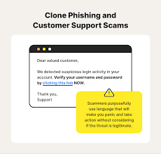
Clone Phishing
Duplication of Legitimate Emails
Clone phishing involves copying a legitimate email sent by a trusted source, then modifying it with malicious links or attachments.
Attackers resend the email, pretending to be the original sender, with slight changes that are hard to notice.
Exploits Trust and Familiarity
Since the recipient has already seen a similar email, they are more likely to trust it.
Example: A cloned email from a service provider asking the user to “reconfirm” their account information.

Slide 8
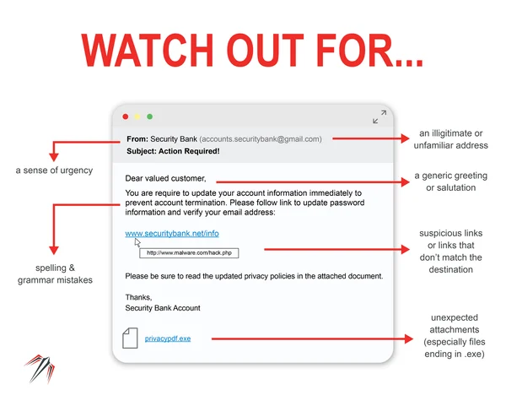
HOW TO RECOGNIZE PHISHING ATTEMPTS
Suspicious Language and Content
Be cautious of emails with poor grammar, spelling mistakes, or overly urgent phrases like “Act Now!” or “Your account will be deactivated.”
Emails offering unexpected rewards or prizes (e.g., “You’ve won a $1,000 gift card!”) are often phishing attempts.
Incorrect or Mismatched URLs
Hover over links to verify the URL before clicking.
Fake links often mimic legitimate websites but have slight differences (e.g., "www.paypa1.com" instead of "www.paypal.com").

Slide 9
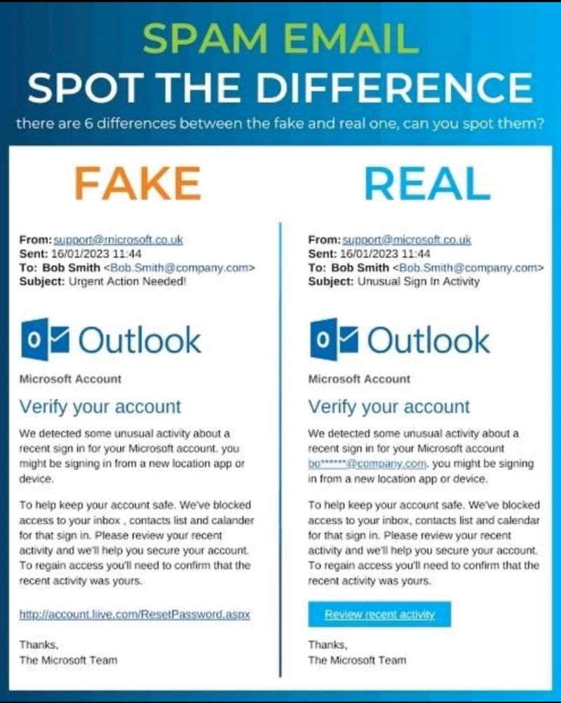
COMPARISON OF LEGITIMATE VS. PHISHING EMAILS
Sender Information
Legitimate Email: Comes from a verified sender with a recognizable and professional email domain (e.g., support@amazon.com).
Phishing Email: Often uses a slightly altered domain (e.g., support@amaz0n.com) or generic, unverified email addresses (e.g., amazoncustomerservice@gmail.com).
Links and Language
Legitimate Email: Links direct to the official website and have consistent branding. The language is professional and clear.
Phishing Email: Links redirect to fake or malicious websites, and the language often includes spelling errors, grammatical issues, or excessive urgency like “Verify Now” or “Update Immediately.”

Slide 10
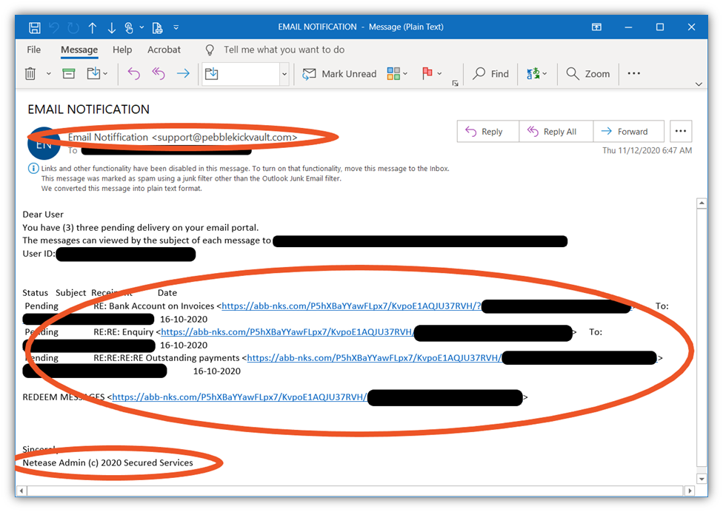
HOW TO AVOID PHISHING ATTACKS
Verify Emails from Unknown Senders
Always cross-check the sender's email address for authenticity.
If the email seems suspicious, contact the organization directly using verified contact details instead of replying to the email.
Avoid Clicking on Links Directly from Emails
Hover over links to inspect the URL before clicking.
Access websites by typing the URL directly into your browser instead of clicking on embedded links in emails.

Slide 11
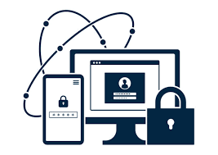

Use Multi-Factor Authentication (MFA)
Add an extra layer of security by enabling MFA on all accounts.
Even if attackers obtain your password, they cannot access your account without the second authentication factor (e.g., OTP, biometric verification).
Keep Systems and Software Updated
Regularly update your operating system, antivirus software, and apps to patch security vulnerabilities.
Outdated software is a common entry point for phishing-related malware attacks.

Slide 12
CASE STUDY OR QUIZ
. Insert Phishing Email Screenshot
Find or create a realistic phishing email screenshot that includes the following red flags:
Suspicious sender address (e.g., support@paypa1.com).
Urgent subject line (e.g., "Your Account Will Be Locked!").
Fake URL (e.g., http://paypa1.com). Correct
Spelling or grammar mistakes (e.g., “verify imediately”).
Suspicious attachment (e.g., invoice.exe)

Slide 13
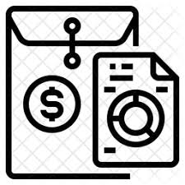

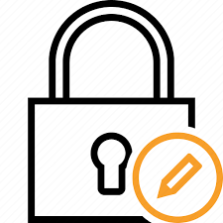
WHAT TO DO IF YOU ENCOUNTER PHISHING
1. Report the Phishing Email to IT/Security Team
Forward the phishing email to your organization's IT or security team to investigate and mitigate further risks.
Tip: Include any relevant details like the sender’s address and the subject line.
2. Avoid Replying or Clicking on Links
Do not engage with the email by replying, opening attachments, or clicking any links.
Tip: Hover over links to check if the URL looks suspicious.
3. Change Compromised Passwords Immediately
If you suspect that you have clicked on a phishing link or entered sensitive information, change your passwords immediately.
Use strong, unique passwords for each account, and enable multi-factor authentication (MFA) for added protection.

Slide 14

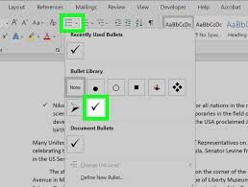

CONCLUSION
Importance of Being Alert
Phishing attacks are one of the most common forms of cybercrime.
Staying vigilant and aware of the signs can help prevent data theft, financial loss, and security breaches.
Steps to Recognize and Avoid Phishing
Verify email senders and check for suspicious addresses.
Hover over links to inspect URLs before clicking.
Look out for urgent language or unexpected requests for personal information.
Use multi-factor authentication (MFA) to secure your accounts.
Report phishing attempts to IT/security teams immediately.
Call to Action:
"Stay vigilant and protect your data. Cybersecurity starts with you!"

